Slide 1
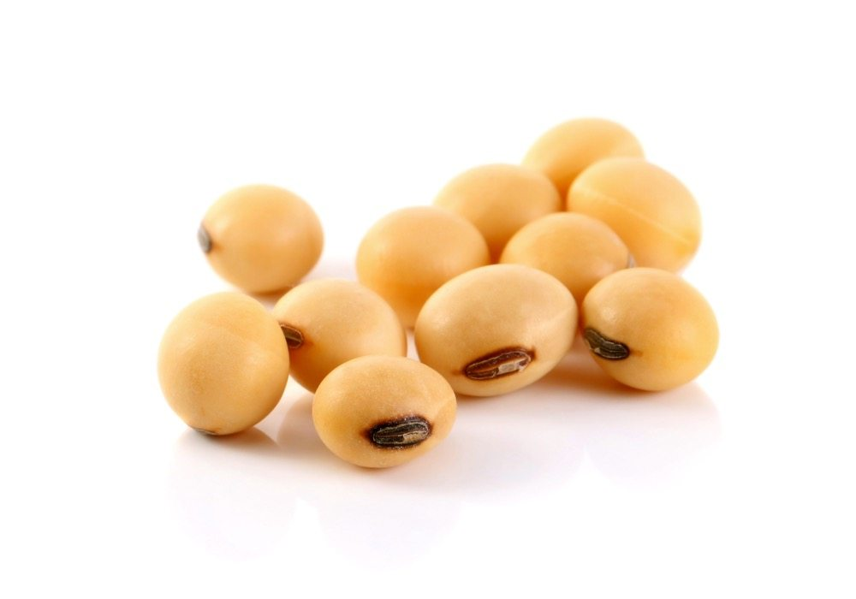
Soybean plant and harvest times in Brazil
August 15, 2018

Slide 2

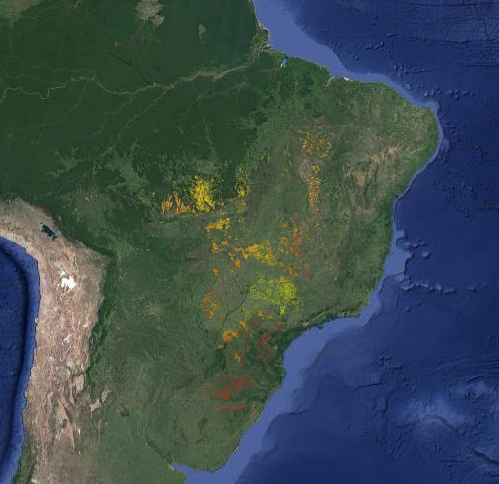
Goal:
Map of field-scale soybean planting and harvest dates across Brazil
Crop timing information:
Is an important input to crop models
Traces farmer response to climate perturbations
Is scarce but much needed in Brazil, which produces 30% of global soy
(an intermediary product)
Notes:
I’m working on estimating soybean planting and harvest dates at the field scale across Brazil
Show a map of either peak dates or planting dates (if available) and talk about it was created, validate, and future improvements and analyses to do on it
There are many ways a planting/harvest date map (i.e., knowing spatial and temporal trends in planting/harvest date) would be useful
First, planting and harvesting dates mediate the weather experienced by a crop during its growing season, and are therefore crucial to accurate crop modeling. Robust models of soy yield are especially important in Brazil, whose soy production accounts for 30% of the world’s supply but is vulnerable both to global climate change and to regional climate change induced by widespread deforestation.
Second, we can trace the effect of changes in climate, econ, institution change, etc (but especially weather) on farmer decisions (i.e. when to plant is largely impacted by onset of rainy season) - this is important because agri impacts climate, which impacts when to plant, which impacts yield. The crop timing maps produced with this method are essential for tracing spatial and temporal changes in farmer behavior in response to weather forcings, and thus help predict how farmers will shift planting and harvesting in response to anomalies in future climate.
Show some kind of cycle of factors that affect each other, and where plant/harvest date decisions lie in this (as motivation to understand how land use change -> climate -> yields)
Unfortunately, field-level soybean planting and harvest data over Brazil are scarce because data collection requires extensive survey work, becoming impractical at scale.

Slide 3
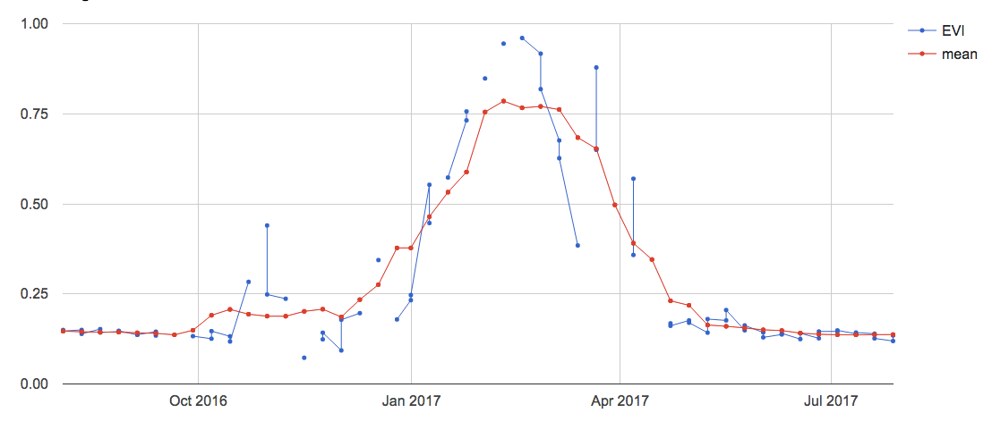
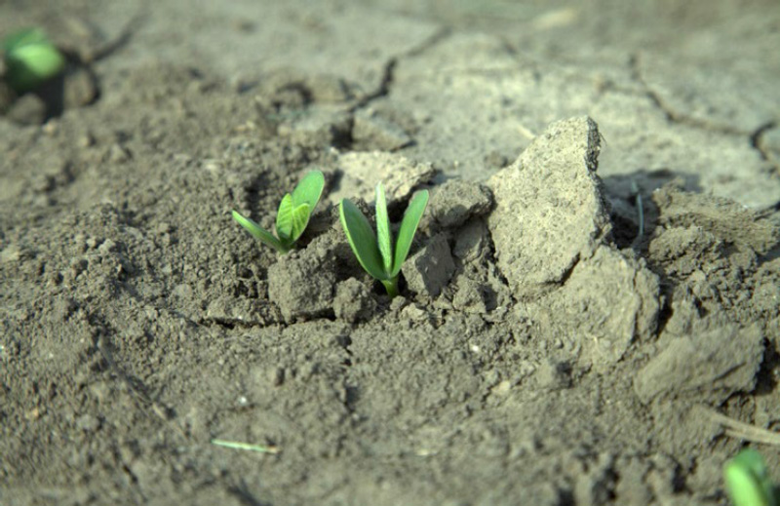
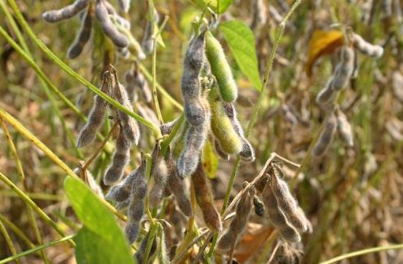
Estimate plant/harvest using remotely sensed vegetation indices
EVI
MODIS-derived EVI
Moving average EVI
Emergence stage
Mature stage
Growth stages of plants are estimated through timeseries analysis
Planting/harvest dates are related to these growth stages
Notes:
Characterize timing of soy by using EVI timeseries calculated from MODIS
Show example of cloud filtered but not smoothed EVI timeseries
First thing is to smooth and find peak time and quarter period
Show example of smoothed EVI, smoothed first derivative, and quarter period
Do this for every pixel across Brazil and use a land use map to highlight only the single or double cropped soy areas
Show GEE peak timing explorer sample results to get a sense of spatial and temporal spread
The peak estimates are quite robust but the quarter periods are not
Tried different combos of peak and quarter period
Show graphic of where the best estimate for plant/harvest lie wrt EVI curve

Slide 4
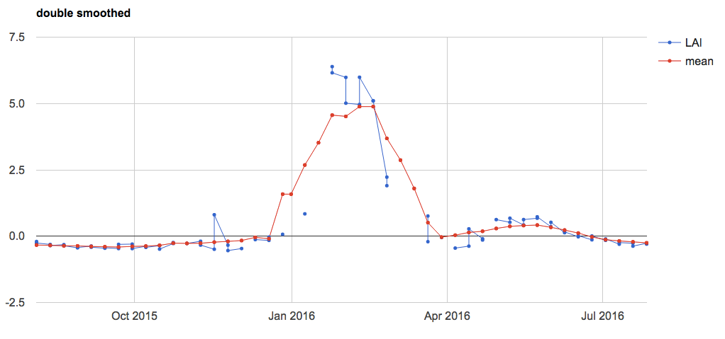
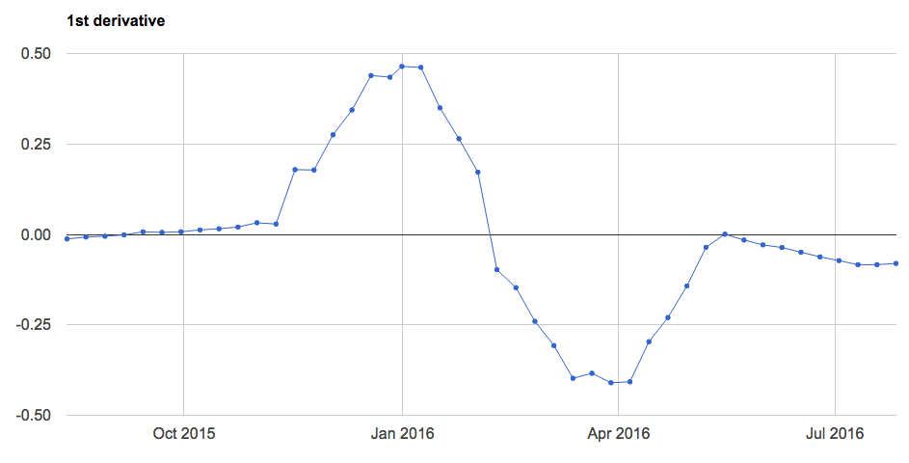
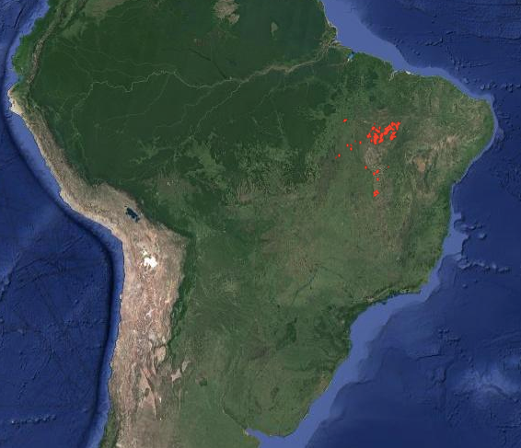
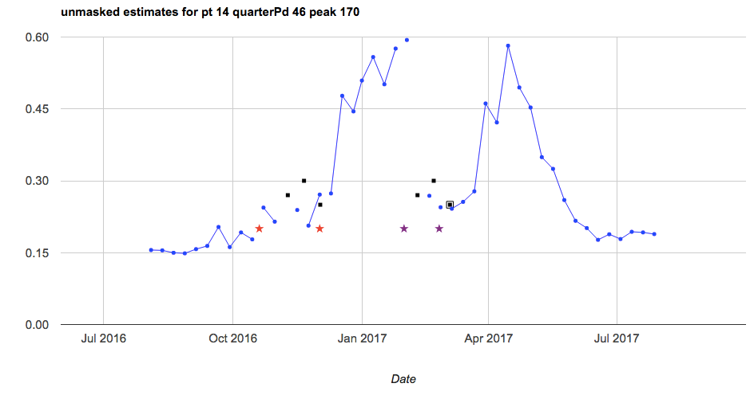
Estimate plant/harvest using remotely sensed vegetation indices
1. Smoothed and fitted EVI timeseries
2. Peak time,
Crop cycle length
Picture of derivatives and fitted harmonic function, and example of the corresponding peak time, cycle length
3. Testing different methods/ combos of peak time, cycle length to get plant/harvest
4. Validate with Matopiba data
Picture of Matopiba polygons and their agricultural area?
Notes:
Validated with a 10-year survey dataset comprising 90 soy farms in the soy “hotspot” of Mapitoba.

Slide 5
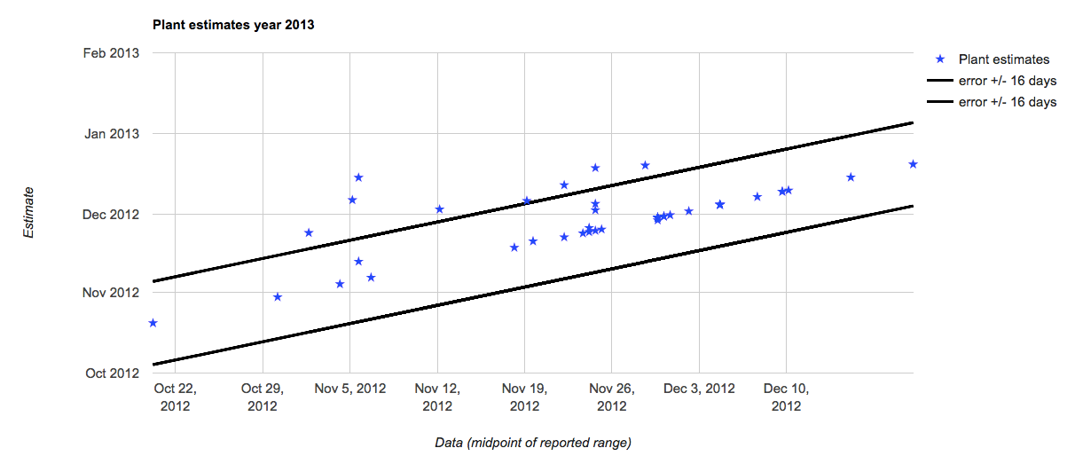
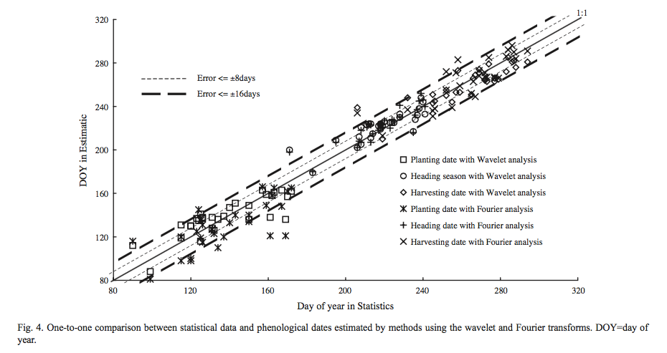
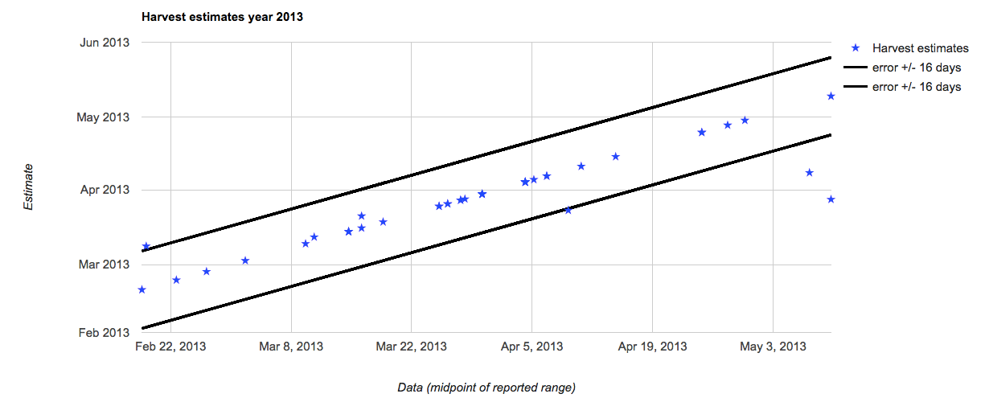
Estimate performance is similar to other studies
(Sakamoto et al, 2005)
Notes:
Initial method evaluation suggests RMSE of about 10 days for both planting date and harvest date estimates.
Show side by side charts to compare my validation to estimations in literature
Example of results (i.e. apply peak timing maps/charts to an initial plant/harvest estimate?)
Take an interesting example to show spatial or temporal variation in plant/harvest date; perhaps overlay with a drought year?
Remember, it’s simultaneously easier and harder to get a good estimate in my case. It’s easier because I’m just targeting a range, whereas they targeted a single day in a field; but my polygons include a lot of natural vegetation, which other studies didn’t have.

Slide 6
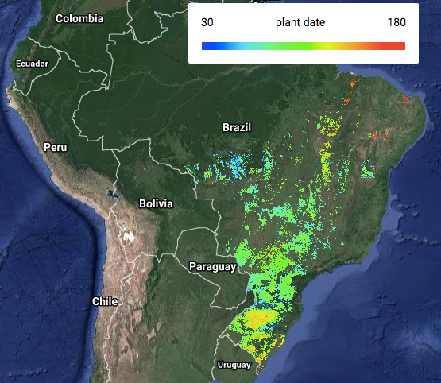
2017 Planting Dates

Slide 7
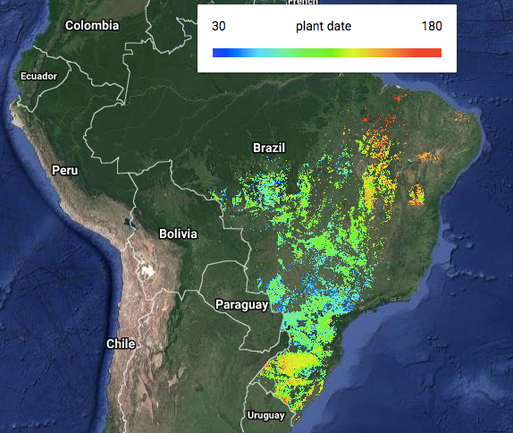
2016 Planting Dates

Slide 8
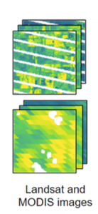
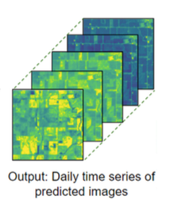
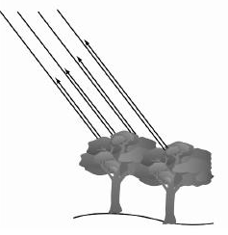
Future work on improving estimations
1. MODIS + Landsat fusion method
(Luo et al, 2018)
3. Radar backscatter band for canopy water content and biomass
Notes:
Use more satellite data to “triangulate” an answer (this is because MODIS EVI is an imperfect indicator of plant status - not direct indicator of photosynthetic activity - and also the 500m resolution probably includes natural vegetation) - so use SIF and Landsat fusion
First, MODIS has low spatial resolution but higher temporal resolution; Landsat has higher spatial resolution but lower temporal resolution, so combine the strengths by fusing them into a new product.
EVI has quasi-linear relationship with fPAR and are physically interpreted as unstressed canopy-level photosynthesis capacity or aboveground biomass, and correlations have been found between some forms of Vis and LAI. However, it has limitations; doesn’t directly measure photosynthesis capacity.
SIF: from GOME-2 (Solar induced fluorescence is the energy emitted from the canopy chlorophyll during photosynthesis, so in theory it contains more info about vegetation photosynthetic activity than Vis)
QuikSCAT backscatter: radar backscattering signals in Ku band (12- 18 GHz or 1.7 – 2.5 cm) are sensitive to canopy water content and biomass, and has been used to study vegetation phenology.

Slide 9
Future work on establishing climate -> crop timing links
Notes:
Trace the impact of weather fluctuations on plant/harvest dates

